Slide 1

Express and React
Using fetch

Slide 2
1.1. MERN Stack
MongoDB – Express – React – Node.js
User
Agent
Browser
React
App
On
Web
server
Express Middleware
{
Implementation code
}
Node JS runtime Software
Database
Mongo Database
No-sql database
MongoDB
Node.js runtime
Web Server (nginx, Apache http server, IIS)
© 2024 Web Age Solutions All rights reserved

Slide 3
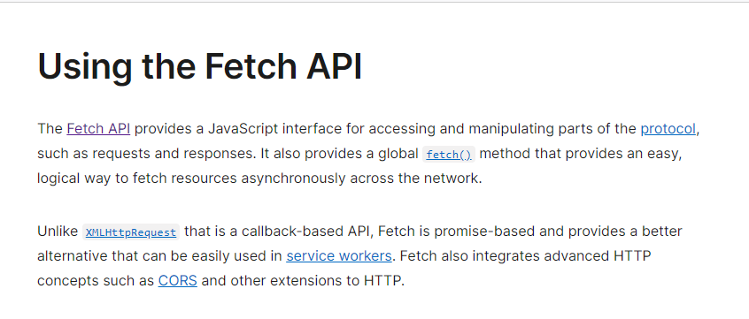
1.2 Fetch API
What is Fetch API?
https://developer.mozilla.org/en-US/docs/Web/API/Fetch_API/
Using Fetch API
https://developer.mozilla.org/en-US/docs/Web/API/Fetch_API/Using_Fetch
© 2024 Web Age Solutions All rights reserved

Slide 4
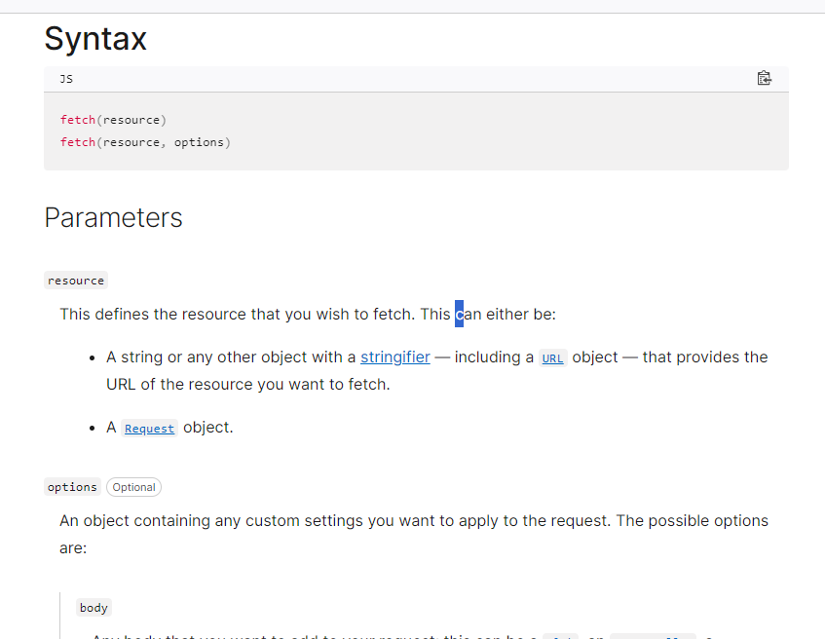
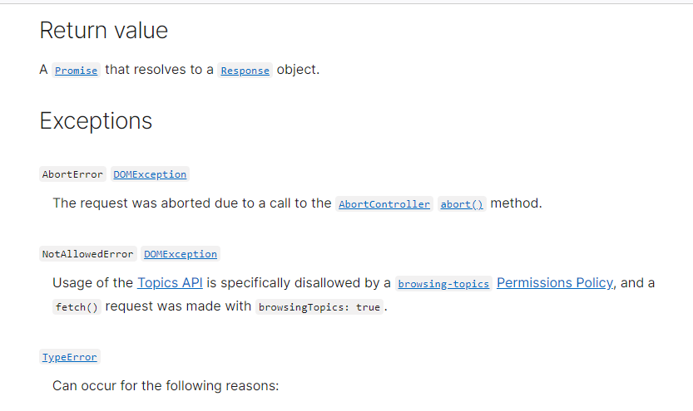
1.3 fetch() global function
https://developer.mozilla.org/en-US/docs/Web/API/fetch
The global fetch() method starts the process of fetching a resource from the network, returning a promise that is fulfilled once the response is available.
The promise resolves to the Response object representing the response to your request.

Slide 5
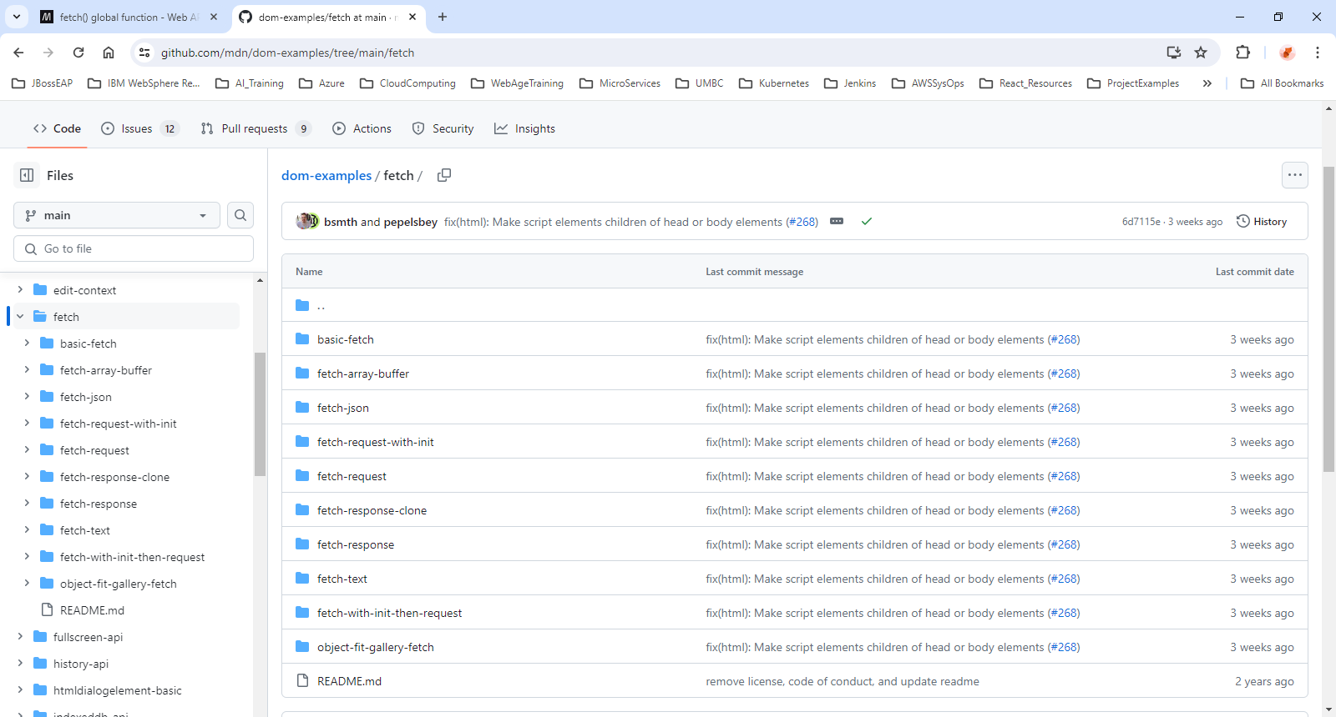
1.4 fetch examples
https://github.com/mdn/dom-examples/tree/main/fetch

Slide 6
1.5 Review the LIVE examples and test them
Basic fetch example
https://mdn.github.io/dom-examples/fetch/basic-fetch/
Fetch array buffer example
https://mdn.github.io/dom-examples/fetch/fetch-array-buffer/
Fetch JSON example
https://mdn.github.io/dom-examples/fetch/fetch-json/
Basic Fetch example with Request object
https://mdn.github.io/dom-examples/fetch/fetch-request/
Basic Fetch example with Request object and Init object
https://mdn.github.io/dom-examples/fetch/fetch-request-with-init/
Basic Fetch example with returned Response properties
https://mdn.github.io/dom-examples/fetch/fetch-response/
Fetch cloned Response example
https://mdn.github.io/dom-examples/fetch/fetch-response-clone/
Fetch text example
https://mdn.github.io/dom-examples/fetch/fetch-text/

Slide 7
1.6 Basic fetch example
<script>
const myImage = document.querySelector(".my-image");
fetch("flowers.jpg")
.then((response) => {
if (!response.ok) {
throw new Error(`HTTP error, status = ${response.status}`);
}
return response.blob();
})
.then((myBlob) => {
const objectURL = URL.createObjectURL(myBlob);
myImage.src = objectURL;
})
.catch((error) => {
const p = document.createElement("p");
p.appendChild(document.createTextNode(`Error: ${error.message}`));
document.body.insertBefore(p, myImage);
});
</script>

Slide 8
1.7 fetch array buffer example
// use fetch to load an audio track, and decodeAudioData to decode it and stick it in a buffer.
// Then we put the buffer into the source
function getData() {
const audioCtx = new AudioContext();
return fetch("viper.ogg")
.then((response) => {
if (!response.ok) {
throw new Error(`HTTP error, status = ${response.status}`);
}
return response.arrayBuffer();
})
.then((buffer) => audioCtx.decodeAudioData(buffer))
.then((decodedData) => {
const source = new AudioBufferSourceNode(audioCtx);
source.buffer = decodedData;
source.connect(audioCtx.destination);
return source;
});
}

Slide 9
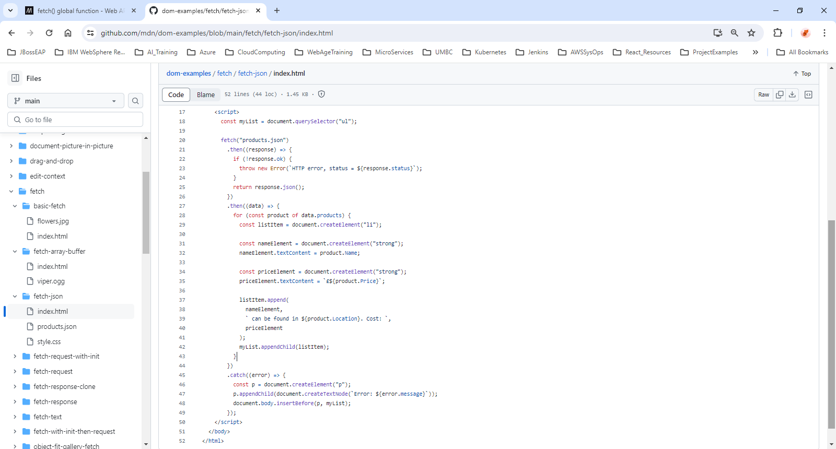
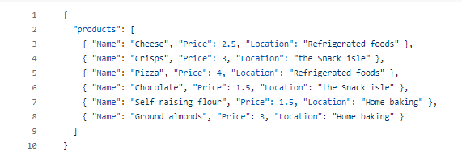
1.8 fetch json data

Slide 10
1.9 fetch request example
<h1>Fetch Request example</h1>
<img src="" />
<script>
const myImage = document.querySelector("img");
const myRequest = new Request("flowers.jpg");
fetch(myRequest)
.then((response) => {
if (!response.ok) {
throw new Error(`HTTP error, status = ${response.status}`);
}
return response.blob();
})
.then((myBlob) => {
const objectURL = URL.createObjectURL(myBlob);
myImage.src = objectURL;
})
.catch((error) => {
const p = document.createElement("p");
p.appendChild(document.createTextNode(`Error: ${error.message}`));
document.body.insertBefore(p, myImage);
});

Slide 11
1.10 fetch response example
const myImage = document.querySelector("img");
const myRequest = new Request("flowers.jpg");
fetch(myRequest)
.then((response) => {
console.log("response.type =", response.type);
console.log("response.url =", response.url);
console.log("response.userFinalURL =", response.useFinalURL);
console.log("response.status =", response.status);
console.log("response.ok =", response.ok);
console.log("response.statusText =", response.statusText);
console.log("response.headers =", response.headers);
if (!response.ok) {
throw new Error(`HTTP error, status = ${response.status}`);
}
return response.blob();
})
.then((myBlob) => {
const objectURL = URL.createObjectURL(myBlob);
myImage.src = objectURL;
})
.catch((error) => {
const p = document.createElement("p");
p.appendChild(document.createTextNode(`Error: ${error.message}`));
document.body.insertBefore(p, myImage);
});
const myBlob = new Blob();
const options = { status: 200, statusText: "SuperSmashingGreat!" };
const myResponse = new Response(myBlob, options);

Slide 12
Express and React
Axios – Getting Started

Slide 13
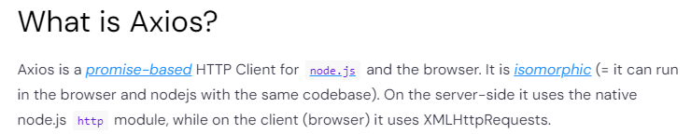
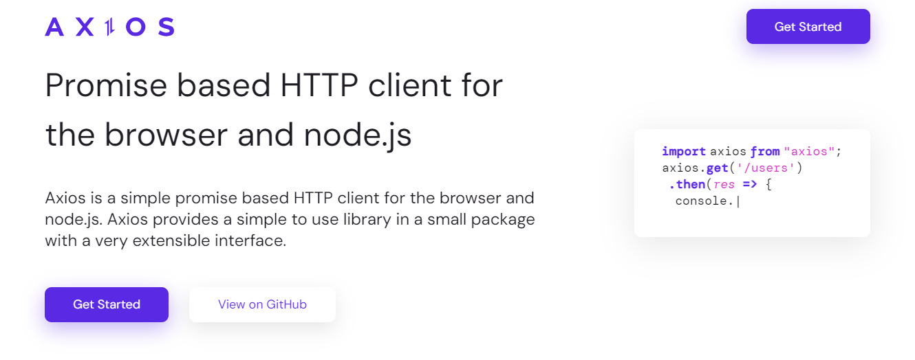
2.1. What is Axios? Getting Started
https://axios-http.com/docs/intro
© 2024 Web Age Solutions All rights reserved

Slide 14
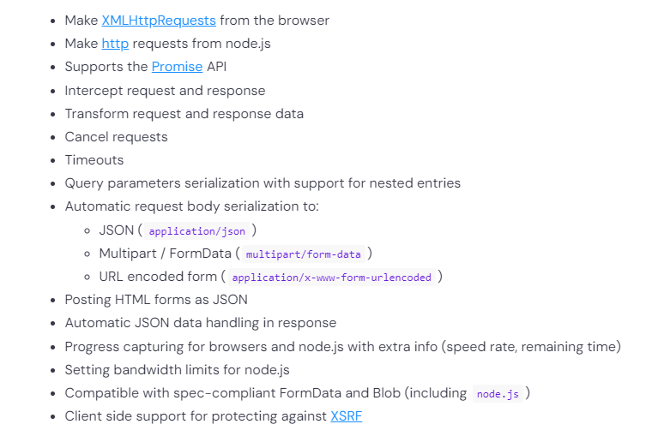
2.2. Axios Features
© 2024 Web Age Solutions All rights reserved

Slide 15
2.3. Installing Axios
Using npm
npm install axios
Using bower
bower install axios
Using yarn
yarn add axios
Using jsDelivr CDN
<script src="https://cdn.jsdelivr.net/npm/axios/dist/axios.min.js"></script>
Using unpkg CDN
<script src="https://unpkg.com/axios/dist/axios.min.js"></script>
Prebuilt CommonJS modules for direct importing with require
const axios = require('axios/dist/browser/axios.cjs'); // browser
const axios = require('axios/dist/node/axios.cjs'); // node
© 2024 Web Age Solutions All rights reserved

Slide 16
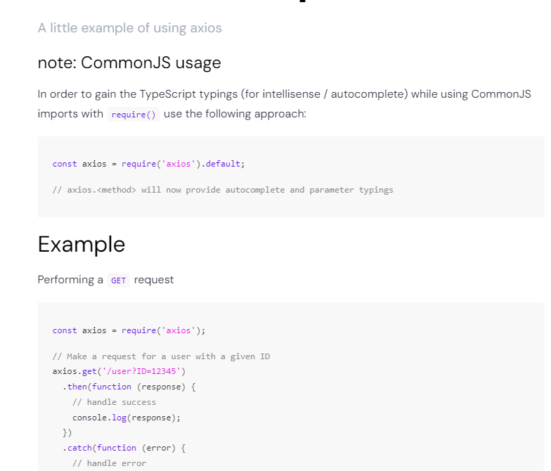
2.4. Axios – minimal example
https://axios-http.com/docs/example
© 2024 Web Age Solutions All rights reserved

Slide 17
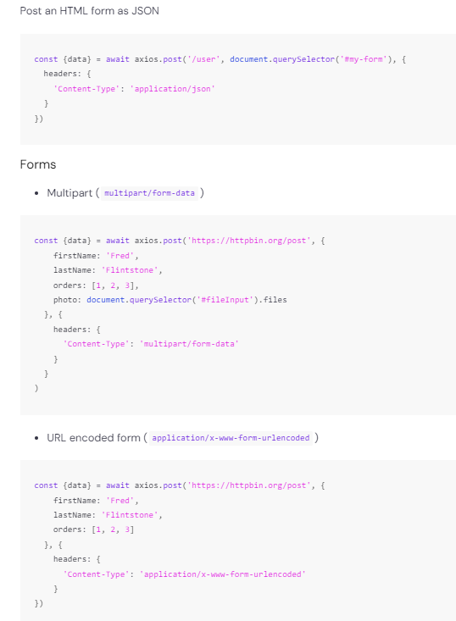
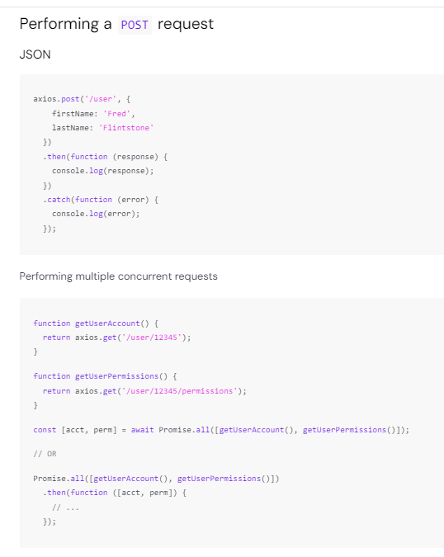
2.5. Axios – POST example
https://axios-http.com/docs/post_example
© 2024 Web Age Solutions All rights reserved

Slide 18
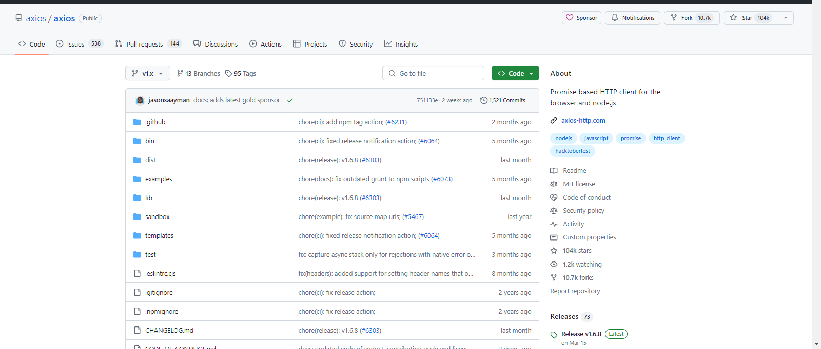
2.6. Axios – GitHub
https://github.com/axios/axios
© 2024 Web Age Solutions All rights reserved

Slide 19
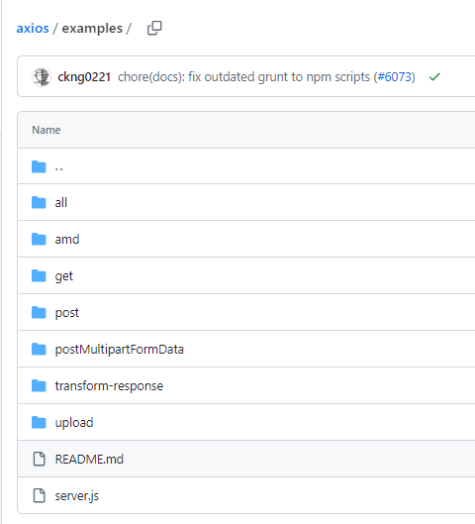
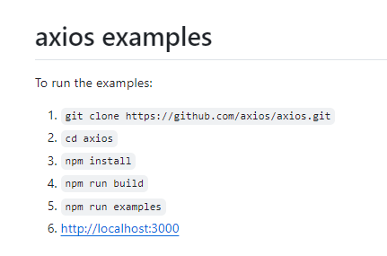
2.7. Axios – Examples
https://github.com/axios/axios/tree/v1.x/examples
© 2024 Web Age Solutions All rights reserved

Slide 20
Express and React
Fetch Vs Axios

Slide 21
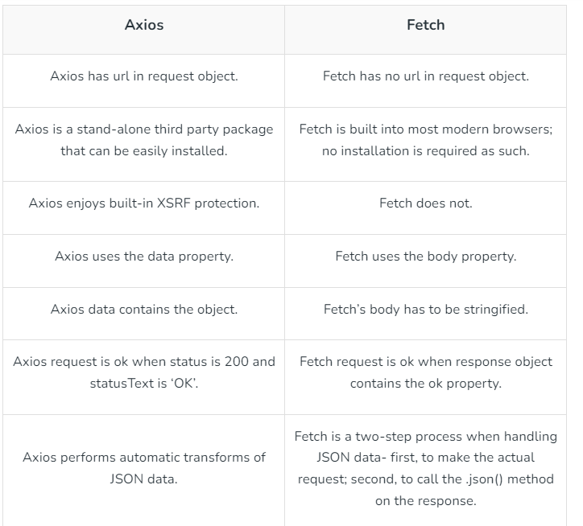
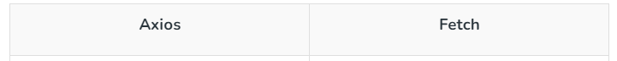
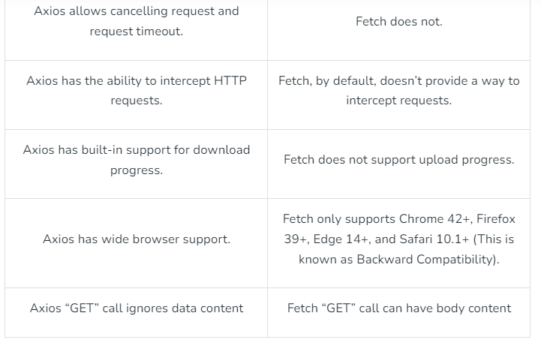
3.1. Axios vs Fetch
Difference between Axios and Fetch
https://www.geeksforgeeks.org/difference-between-fetch-and-axios-js-for-making-http-requests
© 2024 Web Age Solutions All rights reserved

Slide 22
3.2. Axios vs Fetch
Axios vs. fetch(): Which is best for making HTTP requests?
https://blog.logrocket.com/axios-vs-fetch-best-http-requests/
JavaScript Fetch vs Axios: Which One Should You Use?
https://nawazdanish.medium.com/javascript-fetch-vs-axios-which-one-should-you-use-e57c4d091096
Fetch API data with Axios and display it in a React app with hooks
https://levelup.gitconnected.com/fetch-api-data-with-axios-and-display-it-in-a-react-app-with-hooks-3f9c8fa89e7b
30 Days Of React: Fetch and Axios
https://github.com/Asabeneh/30-Days-Of-React/blob/master/18_Fetch_And_Axios/18_fetch_axios.md
Axios vs Fetch: Which is best for HTTP requests in 2024?
https://apidog.com/blog/axios-vs-fetch/
© 2024 Web Age Solutions All rights reserved

